Slide 1
Search Marketing
Fall 2025
CUHK MSc in Marketing

Slide 2
Some Announcements
Group Project:
Group project proposal presentation
A digital marketing strategy consulting report

Slide 3
Group Project
Overall project objectives:
the understanding of the customer purchase journey and target audiences
the identification and in-depth analysis of selected marketing channels for each stage of the funnel
the provision of recommendations on the holistic marketing plan
an exposure to multichannel marketing efforts

Slide 4
Group Project (Final Presentation)
overview of the company, its goals, and its competitors
the evaluation and tactical assessment of two main digital marketing channels
a summary strategy with insights and suggested areas for improvement, testing, or exploration

Slide 5
Group Project Proposal
Company background, project overview and funnel/target audience analysis
Describe company background to contextualize the project
Define the objective of the company in relation to the company’s products/services
Provide a customized funnel analysis (customer purchase journey)
Identify the target audiences for the digital marketing strategy
Identify potential channels to use to reach the aforementioned target audiences at each stage of the funnel, and explain their pros and cons
Always motivate and provide reasons to support your choices.

Slide 6
Group Project Proposal Some questions to think about
What is the company’s offering?
What is the company’s objective in the short-term and in the long-term?
What is the market structure?
Duopoly, oligopoly, etc.
Notable competitors
Market share
What is unique to the company’s offering that differentiates it from other similar offerings?
What important relevant problems does the company leave unsolved?

Slide 7
Complete Group Project
Display or Search ad strategies
Based on the company’s goals, focus on either Display or Search advertising.
For the chosen channel, you should:
Explain why the channel is better suited at addressing the company’s goal and briefly discuss the other potential channel that was not chosen
Describe the targeting strategy (e.g., demographic-based, contextual-based, keyword strategy, etc.)
Explain the specific metrics to assess the performance of the channel
Describe the ideal experiment that can be used to compute the incremental effect of the ad (and eventually the ROI) in this context
For Display: identify potential issues related to display ad delivery
For Search: describe both SEO and Paid Search strategies, and analyze their trade-off
Notes:
OPTIONAL: provide specific instructions on how to set up and implement the Display campaign/Search strategy

Slide 8
Complete Group Project
Social media, Influencer or E-mail Marketing strategies
Based on the company’s goals, focus on either Social Media or Influencers or E-mail Marketing.
For the chosen channel, you should:
Explain why the channel is better suited at addressing the company’s goal and briefly discuss the other potential channels that were not chosen
Describe the targeting strategy (e.g., demographics, type of influencers, content, etc.)
Provide specific metrics to assess the performance of the channel
For Social Media/Influencers: identify the relevant platforms, describe the strategy in details and explain the benefits and potential risks, provide an example of A/B testing in this context
For Email marketing: describe the type of data needed and potential sources; describe the execution in details and provide and example of how experiments can be used in this context
Notes:
OPTIONAL: provide specific instructions on how to set up and implement the proposed strategy, with reference to existing software tools

Slide 9
Group Project
Start working on it!

Slide 10
Overview
Difference between Organic and Sponsored Search
Sponsored Search Auctions
Search campaign design
Generic vs. Branded Search

Slide 11
Sponsored Search

Slide 12
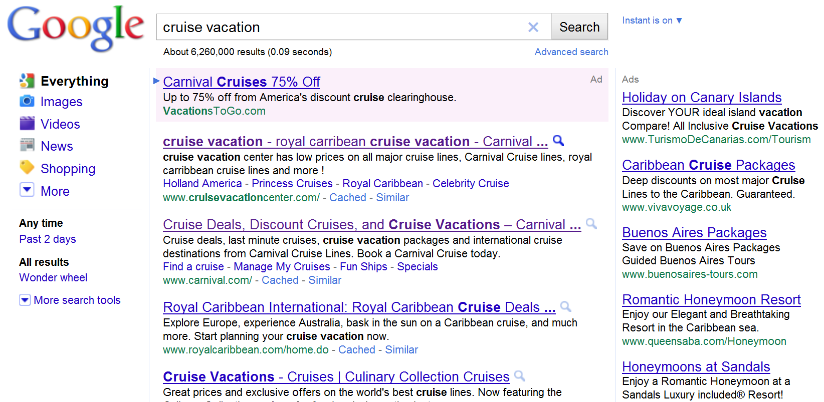
Search Engine Advertising
Paid search results
Rank
Keyword
1
2
3
4
5
6
Organic search results

Slide 13
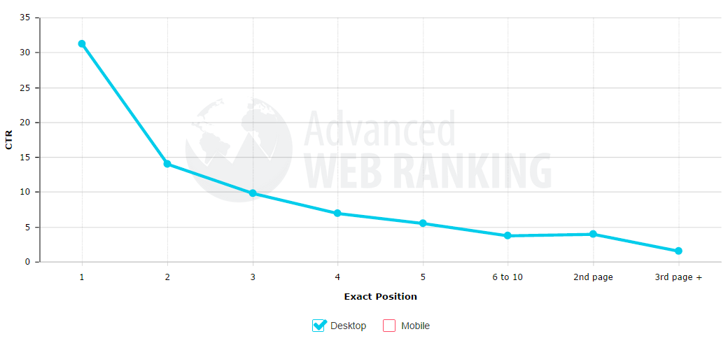
Organic CTR
Source: moz.com

Slide 14
Sponsored CTR

Slide 15
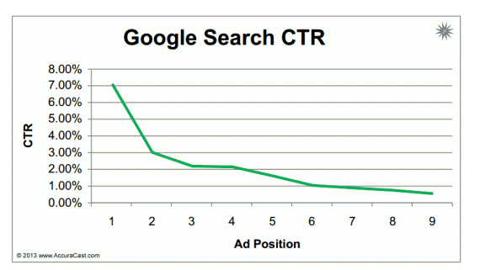
Sponsored CTR

Slide 16
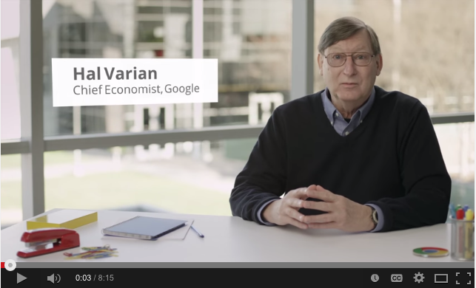
Primer: Hal Varian
Ad Ranking/Pricing: Link

Slide 17
Bidding on Google Ads

Slide 18
Sponsored Jargon
Bid
Quality Score
CTR
Cost Per Click (CPC)

Slide 21
Branded vs. Generic Search
Rutz and Bucklin, “From Generic to Branded”

Slide 22
Branded Search – contains a brand name (“Hilton LA”)
Generic Search – does not (“Hotels LA”)
Pros and cons?

Slide 23
A few facts
Generic search:
More competition
Higher CPC
Lower conversion rate
Higher volume

Slide 24
How would you figure out is Branded advertising worth it?

Slide 25
Sample Data

Slide 26
Possible Paths
Branded
Purchase
Generic

Slide 27
Possible Paths
Branded
Purchase
Generic

Slide 28
Research Results
Without considering generic => branded:
Generic cost of acquisition: $51.81
After considering generic => branded:
“spillover-adjusted” cost: $14.50

Slide 29
Summary
Search Engine Advertising Requires:
Keywords
Bids
Payment Model
Important to know your CPCs from CTRs, Impression vs. Click vs. Conversion etc.
Google Keyword Tool, very useful for ideas.

